Slide 1
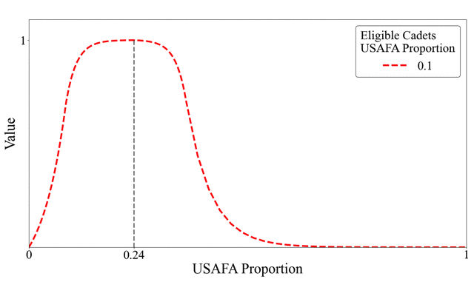
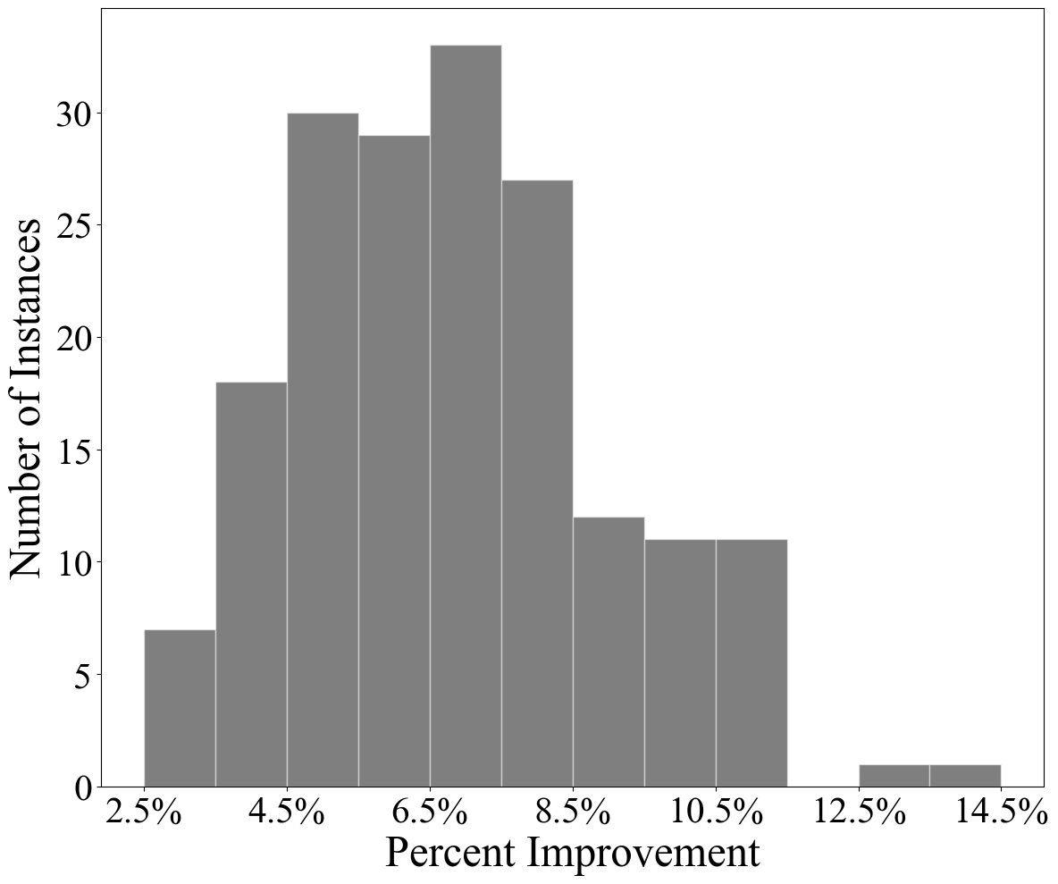
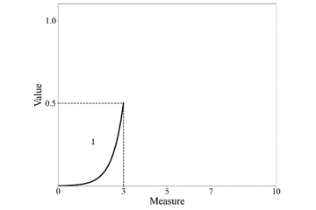
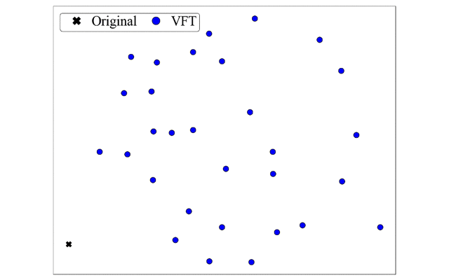
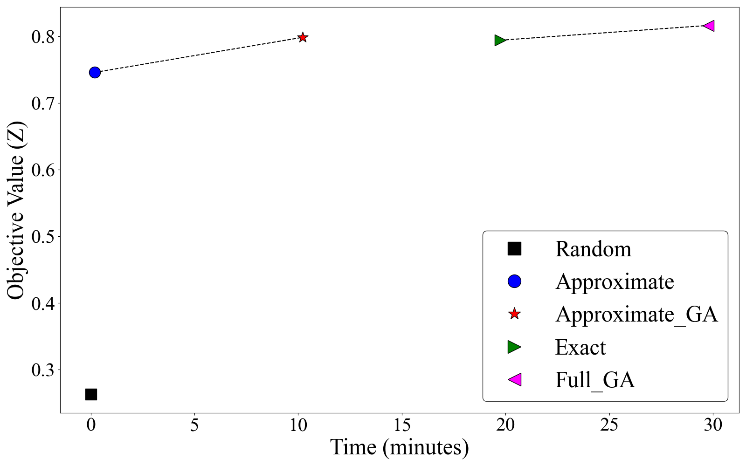
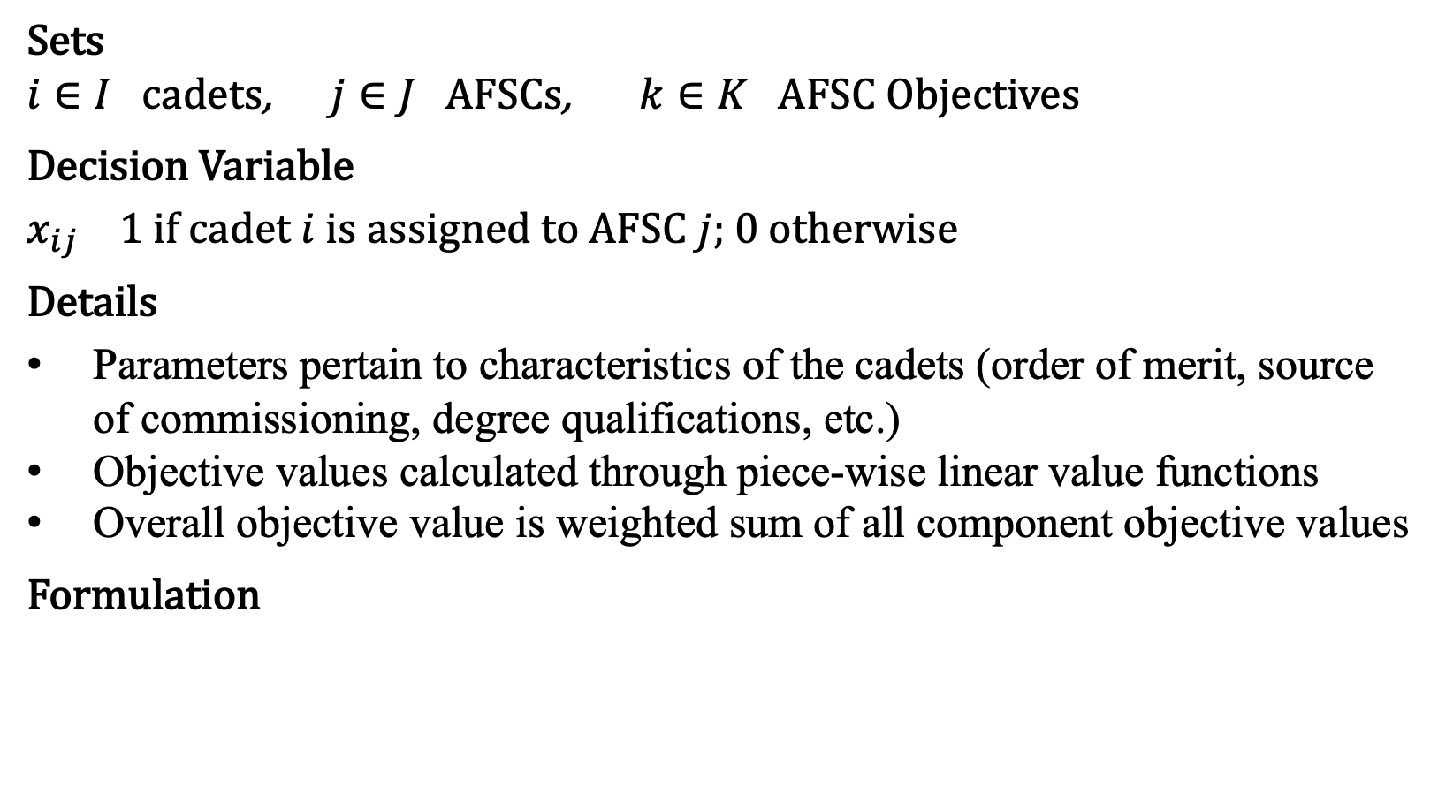
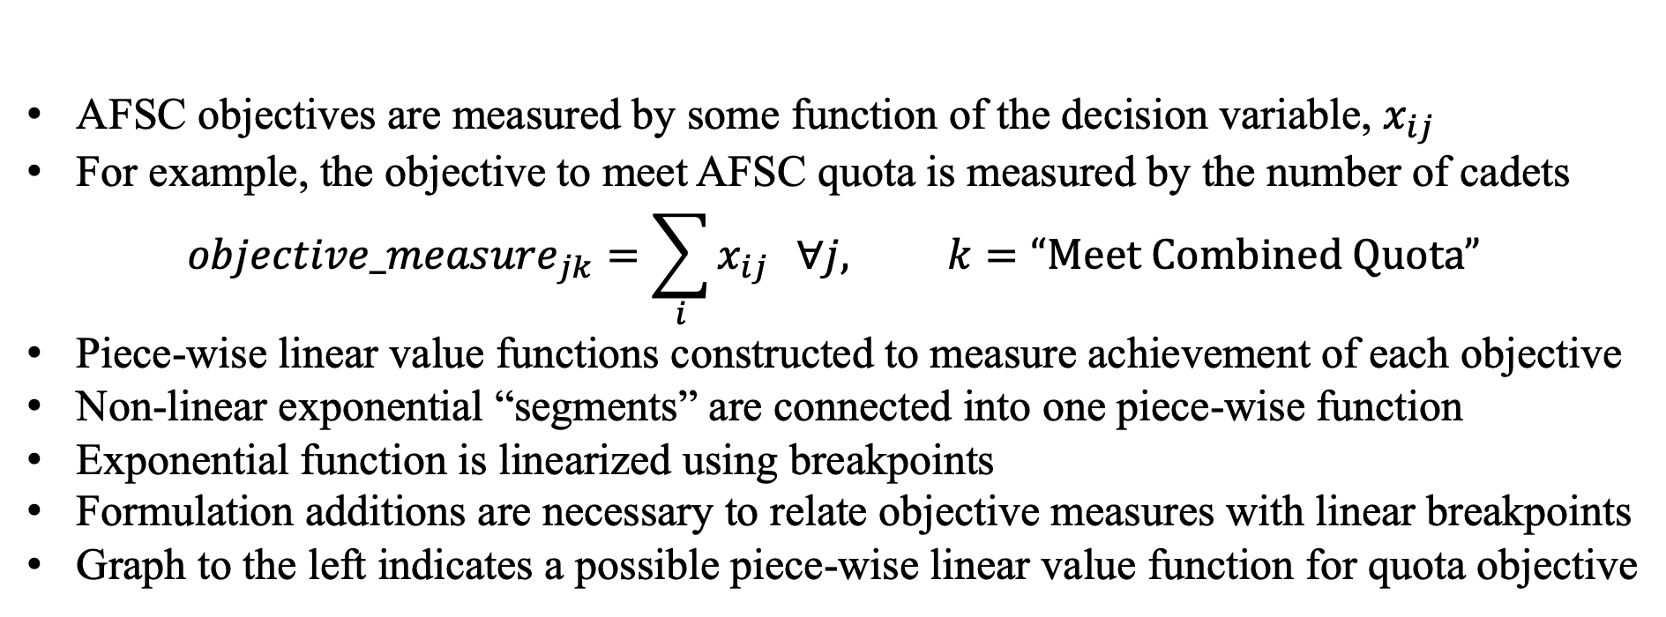
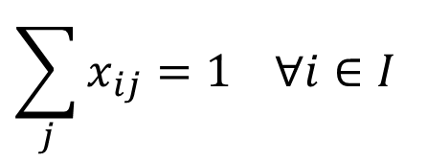
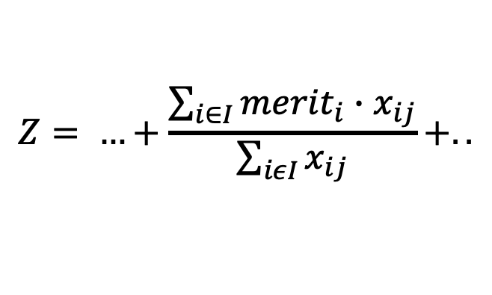
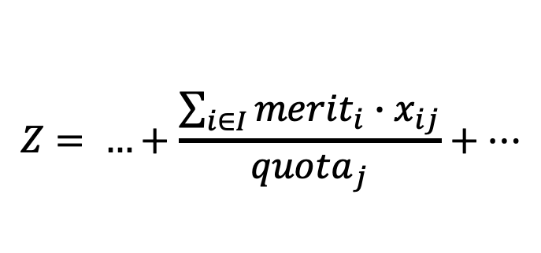
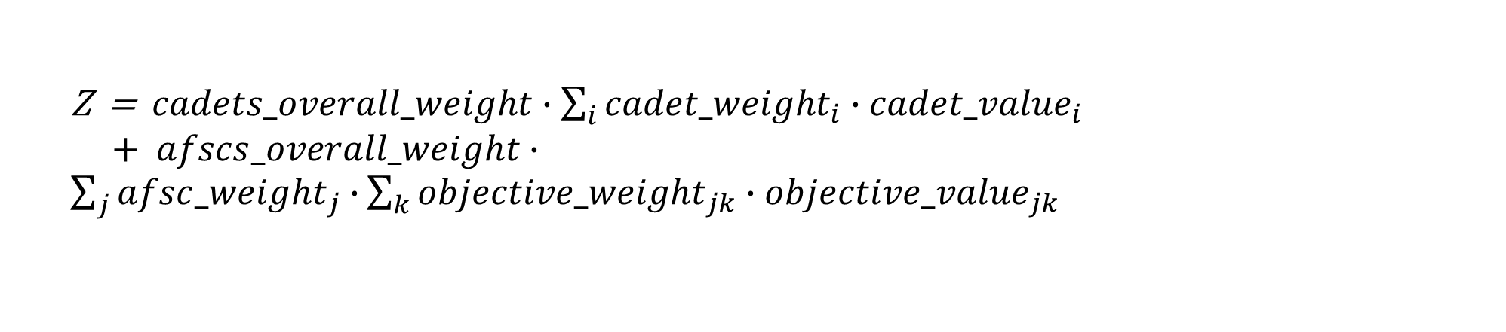
A New Approach to Career Field Matching for Commissioning Air Force Cadets
1st Lt D. Griffen Laird, Advisor: Lt Col Jesse Wales, Ph.D., Committee: Dr. Bruce Cox, Maj Michael Garee, Ph.D.
BACKGROUND
DECISION FRAMEWORK
EXPERIMENT DESIGN
Each year, the Air Force Personnel Center (AFPC) assigns cadets to their career fields, denoted by Air Force Specialty Codes (AFSCs)
Cadets submit preferences, along with utility measures, for the AFSCs they would like to be assigned to
Current method of assignment uses an integer programming model to maximize the overall “utility” of assigning a cadet to an AFSC given certain Air Force-defined constraints
Constraints include filling AFSC quotas, balancing distribution of talent, balancing sources of commissioning, and meeting degree requirements across AFSCs as listed by the Air Force Officer Classification Directory
Stakeholders include cadets, career field managers, HAF/A1 leadership, USAFA/ROTC leadership
Each decision maker (DM) provides input on the components of the solution that matter to them
Objective function must appropriately evaluate overall quality of solution given all DM criteria
Value-Focused Thinking (VFT) based value hierarchy implemented with two primary entities: cadets and AFSCs
Six class years, with real solutions, tested against new VFT model
All values & weights estimated based on original model “priorities”
30 problem instances generated for each class year using different sets of weight and value parameters intended to capture variety of DM tradeoffs
Real solutions measured against VFT solutions using objective hierarchy
Percent improvement of VFT solution over real used as evaluation metric
Example value functions shown below for each objective
OBJECTIVE HIERARCHY
Cadet Objective:
Get their most preferred AFSC
Measured by the utility value they placed on the AFSC they received
Maximize Solution Quality
Potential AFSC Objectives:
Meet combined ROTC/USAFA quota
Meet degree requirement objectives
Balance distribution of talent within each AFSC
Balance ratio of USAFA/ROTC cadets
Maximize utility of the cadets assigned
RESEARCH OBJECTIVES
Analyze several different modeling techniques to determine best fit model of the problem
Validate model output achieves strategic goal of finding the best-known solution assignment of cadets to their career fields
Determine efficient method(s) of solving the new model
Compare and contrast solutions generated by different models given realistic objective/value tradeoff criteria
Maximize Cadet Solution Value
Maximize AFSC Solution Value
Maximize Cadet 1 Utility
…
Maximize Cadet N Utility
Maximize AFSC 1 Value
…
Maximize AFSC M Value
RESULTS & ANALYSIS
OTHER MODELING TECHNIQUES
On average, VFT solutions are 6.82% better than original given same constraints
Using VFT objective function for comparison is necessary to evaluate solutions
Objective function captures DM tradeoffs appropriately
Maximize AFSC 1 Objective 1 Value
Maximize AFSC 1 Objective O Value
Maximize AFSC M Objective 1 Value
Maximize AFSC M Objective O Value
Generalized Assignment Problem
…
…
Objective is to maximize utility subject to cadet/AFSC constraints
Utility function does not adequately evaluate the quality of the solution
“Hard” constraints cause model infeasibility; no trade-offs are captured
VALUE FUNCTIONS
2. Stable Marriage Model
Two sets of entities are matched based on preference lists
Constraints, group preferencing, incomplete lists, ties, etc. all complicate this model as it pertains to the cadet/AFSC problem
AFSC objectives are measured by some function of the decision variable, $x_{ij}$
For example, the objective to meet AFSC quota is measured by the number of cadets
$${objective_measure}_{jk}=\sum_{i}{x_{ij}} ∀j, k=“Meet Combined Quota”$$
Piece-wise linear value functions constructed to measure achievement of each objective
Non-linear exponential “segments” are connected into one piece-wise function
Exponential function is linearized using breakpoints
Formulation additions are necessary to relate objective measures with linear breakpoints
Graph to the left indicates a possible piece-wise linear value function for quota objective
Solution “similarity” metric used to compare two solutions
Similarity defined as proportion of cadets that receive the same AFSC in both solutions
30 VFT solutions w/original model solution for one class year plotted using MDS based on similarity
Original solution is outlier
NEW IP FORMULATION
Sets
$i∈I$ cadets, $j∈J$ AFSCs, $k∈K$ AFSC Objectives
Decision Variable
$x_{ij}$ 1 if cadet $i$ is assigned to AFSC $j$; 0 otherwise
Details
Parameters pertain to characteristics of the cadets (order of merit, source of commissioning, degree qualifications, etc.)
Objective values calculated through piece-wise linear value functions
Overall objective value is weighted sum of all component objective values
Formulation
SOLUTION METHODOLOGY
Non-linear term in objective function (division by variable)
Approximate sum of cadets assigned to AFSC with the quota
Two models: non-linear (“Exact”) and linear (“Approximate”)
Exact model objective function value used to compare solutions
Genetic Algorithm (GA) developed to evolve solutions further
Approximate model finds good solutions quickly
CONCLUSIONS
Results averaged across 60 problem instances generated by conditional tabular generative adversarial network
Using the same constraints as the original model, the VFT model can find better solutions given any decision criteria
VFT solutions are more similar to each other than they are to the original solution (better solutions exist that would have remained unknown)
VFT model supports wide array of decision maker input at each level of the objective hierarchy
Objective hierarchy is simple and intuitive by nature
Model is flexible and can adjust to fit any kind of solution criteria needed without changing the structure of the framework
max
Z = $cadets_overall_weight∙\sum_{i}{{cadet_weight}_{i}∙{cadet_value}_{i}}$ $+ afscs_overall_weight∙\sum_{j}{{afsc_weight}_{j}∙}\sum_{k}{{objective_weight}_{jk}∙{objective_value}_{jk}}$
subject to
$$\sum_{j}{x_{ij}=1 ∀i∈I}$$
“Exact” Model
“Approximate” Model
${objective_measure}_{jk}≤{measure_max}_{jk}$ $∀j∈J, k∈K$
$$Z= …+\frac{\sum_{i∈I}{{merit}_{i}∙x_{ij}}}{\sum_{iεI}{x_{ij}}}+..$$
$$Z= …+\frac{\sum_{i∈I}{{merit}_{i}∙x_{ij}}}{{quota}_{j}}+…$$
${objective_measure}_{jk}≥{measure_min}_{jk}$ $∀j∈J, k∈K$
Sponsor: Lt Col Mitchell Gillespie, AFPC/DSYA
$x_{ij}∈\{1, 0\}$ $∀i∈I, j∈J$
Warning
Sorry, we cannot load the preview right now. This may be because something on your computer or network is blocking access to the preview files. Please see this help article for advice.
Warning
Sorry, we cannot load the preview right now. This may be because something on your computer or network is blocking access to the preview files. Please see this help article for advice.

